Slide 1

Predicting Room Occupancy Using Environmental Sensor Data
Robert B Fisher
DS 260

Slide 2
Project Overview
Goal: Predict whether an office is occupied using environmental sensor data.
Data collected every few seconds
Target variable: Occupied (0 = No, 1 = Yes)
Machine learning model type: Decision Trees

Slide 3
Dataset Features
Predictors:
Temperature
Humidity
Light
CO2
Humidity Ratio
ID
Target:
Occupied (Yes/No --> 1/0)

Slide 4
Data Cleaning
Main Issue: Inconsistent Occupied labels
Examples: “yes,” “Yes,” “Y,” “N,” “no” missing values
Cleaning Steps:
Converted to lowercase
Trimmed whitespace
Mapped: {“yes,” “y,” “1”} – 1
Mapped: {“no,” “n,” “0”} – 0
Dropped invalid rows

Slide 5
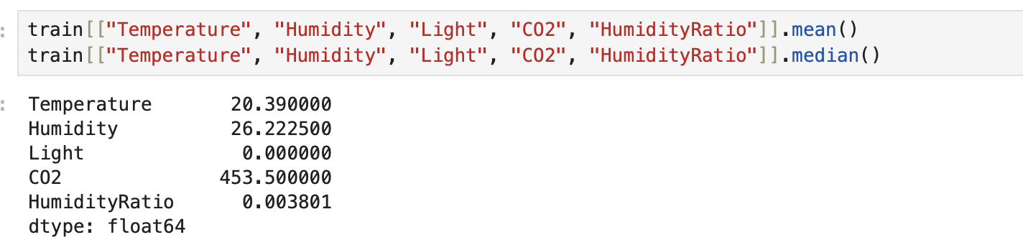
Descriptive Statistics
Purpose:
Understand typical sensor values
Detect skew and outliers
Prepare for model building

Slide 6
Time-Series Exploration
Data collected at regular intervals
Helps Identify which features correlate with occupancy
Built six line charts (one per feature) using KNIME

Slide 7
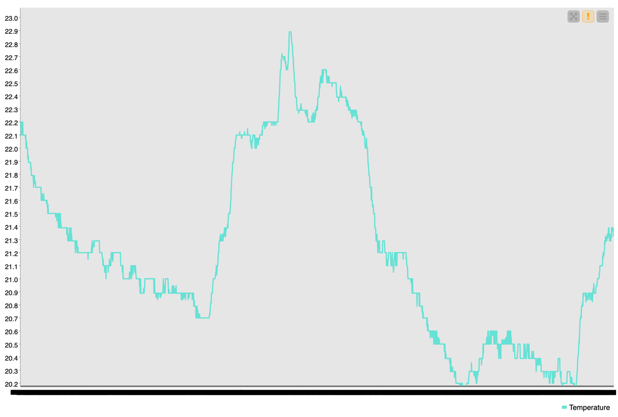
Temperature Over Time
Observation:
Smooth rise/fall between 20-23 Celsius
No Sharp transitions
Changes reflect HVAC cycles, not occupancy
Weak predictor

Slide 8
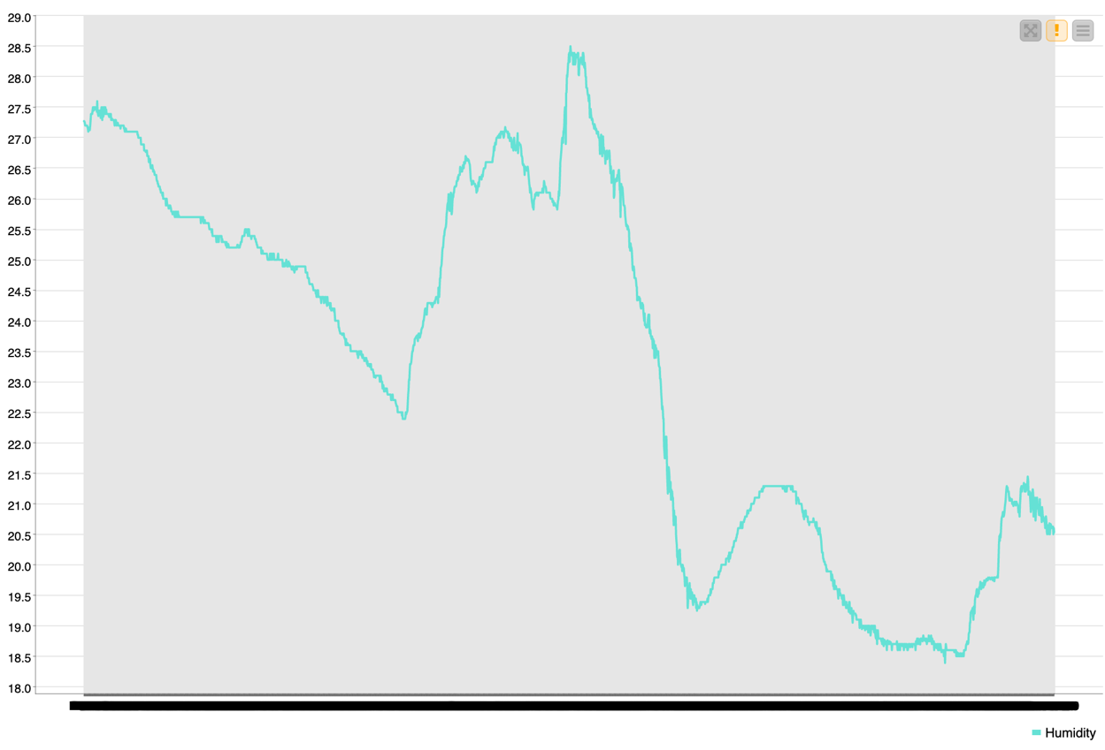
Humidity Over Time
Observation:
Gradual fluctuations between 18-28%
No abrupt spikes
Pattern unrelated to occupancy
Weak predictor

Slide 9
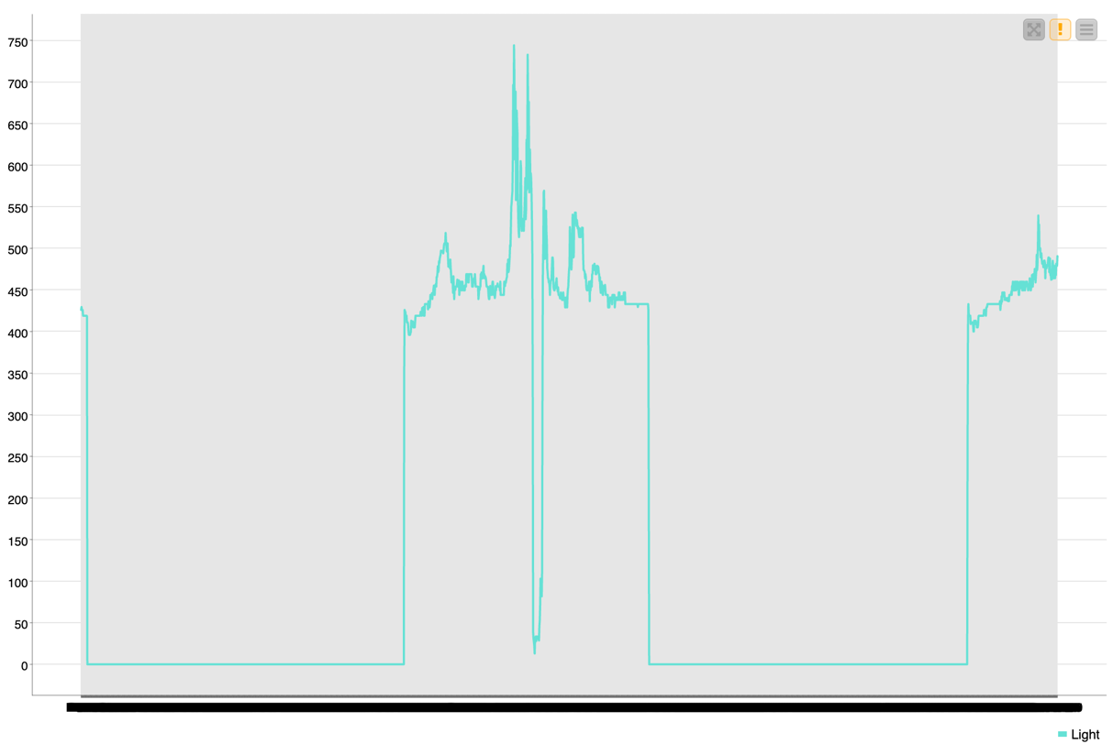
Light Over Time
Observation:
Clear off and on transitions
Unoccupied – near 0 lux
Occupied – jumps to 400-500 lux
Very sharp boundaries
One of the strongest predictors

Slide 10
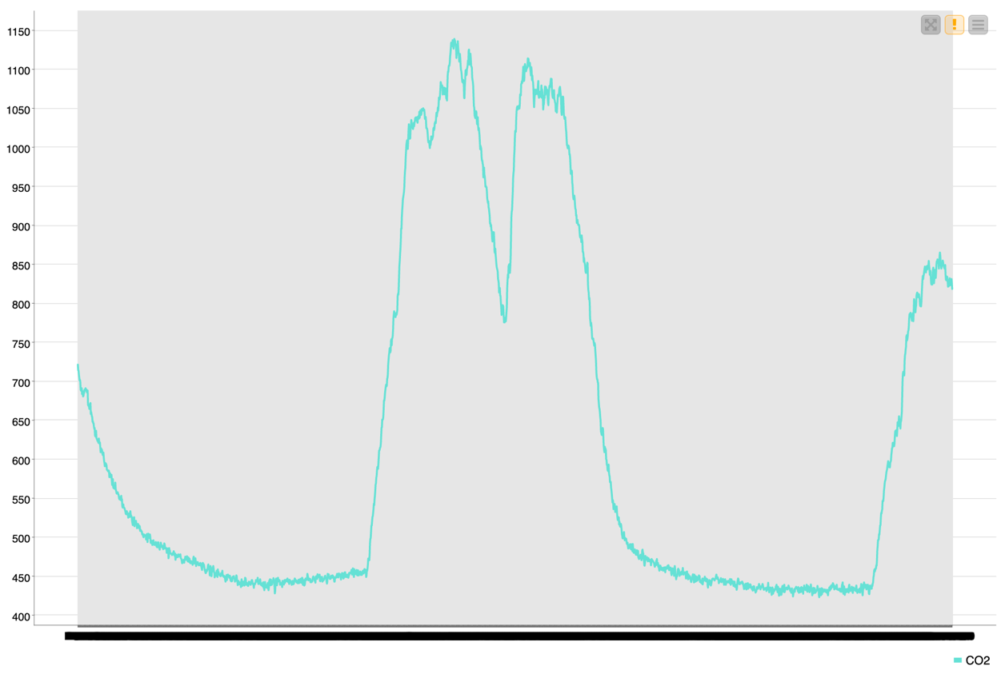
CO2 Over Time
Observation:
Rises dramatically when people are present
Falls back when room empties
Distinct hill shaped occupancy cycles
Very strong predictor

Slide 11
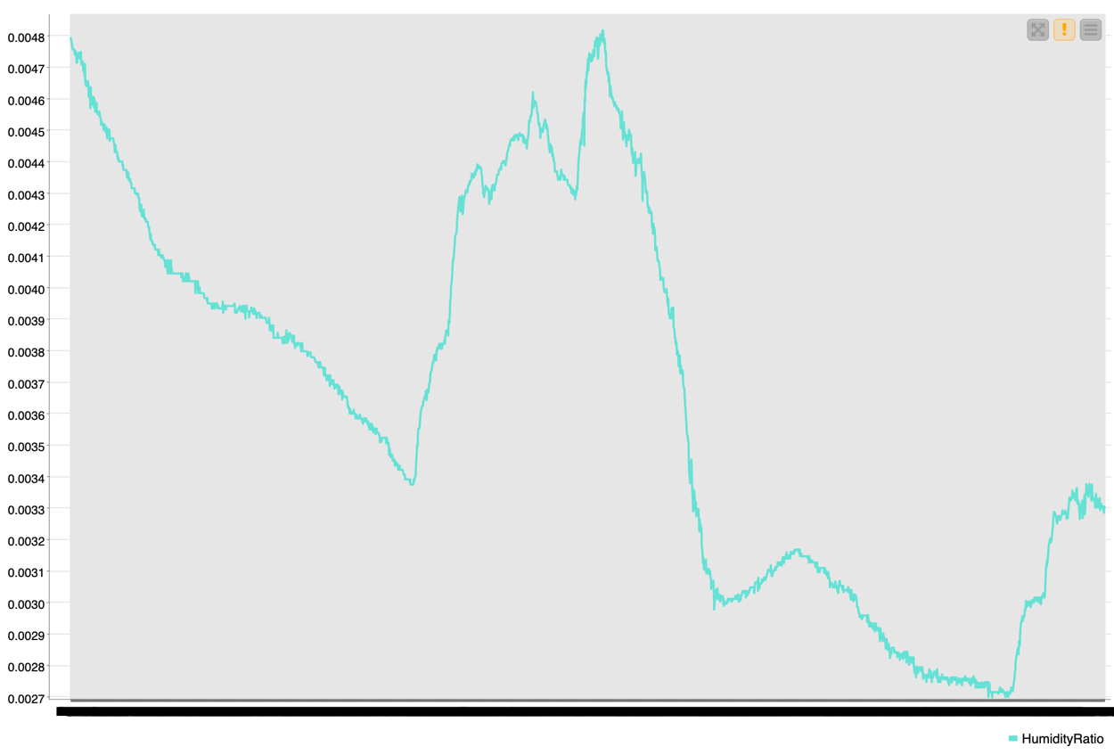
Humidity Ratio Over Time
Observation:
Similar shape to humidity
Smooth, gradual changes
Moderate to weak predictor

Slide 12
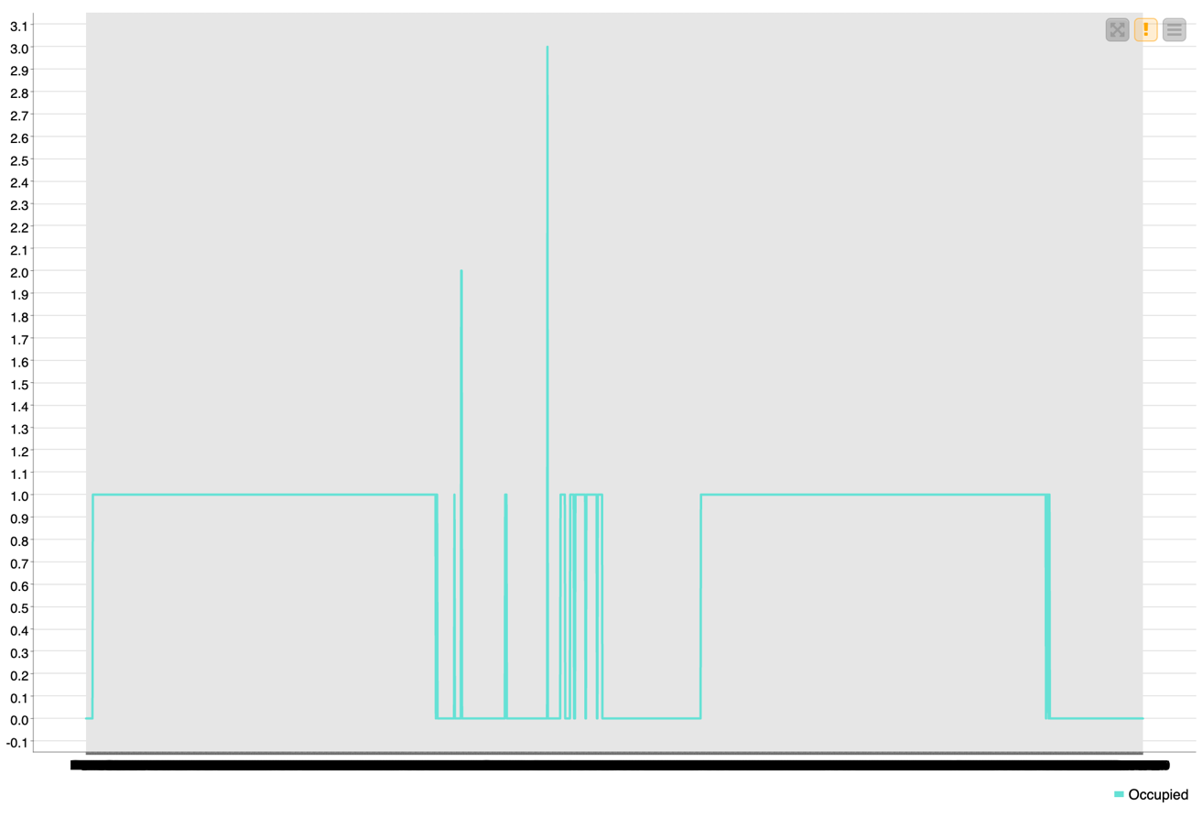
Occupied Over Time
Observation:
Clear blocks of 0s and 1s
Serves as ground truth
Helps visually compare how light and CO2 align with occupancy

Slide 13
Model Building Overview
Built three decision tree models:
All predictors
Light + CO2
Temperature + Humidity + CO2
Evaluated using:
Accuracy
AUC

Slide 14
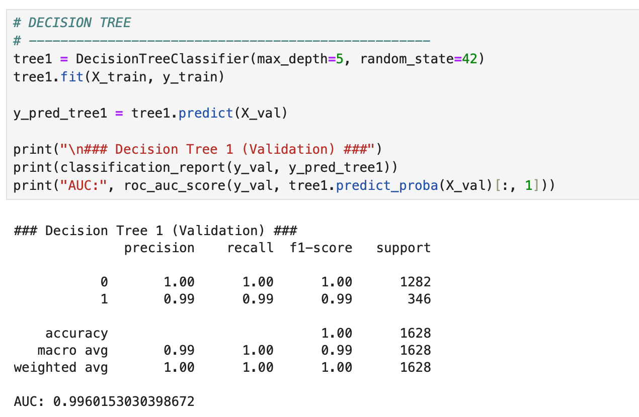
Decision Trees 1
Accuracy: 1.00
AUC: 0.9960
Strong splits based on Light and CO2
Most complete and highest performing model

Slide 15
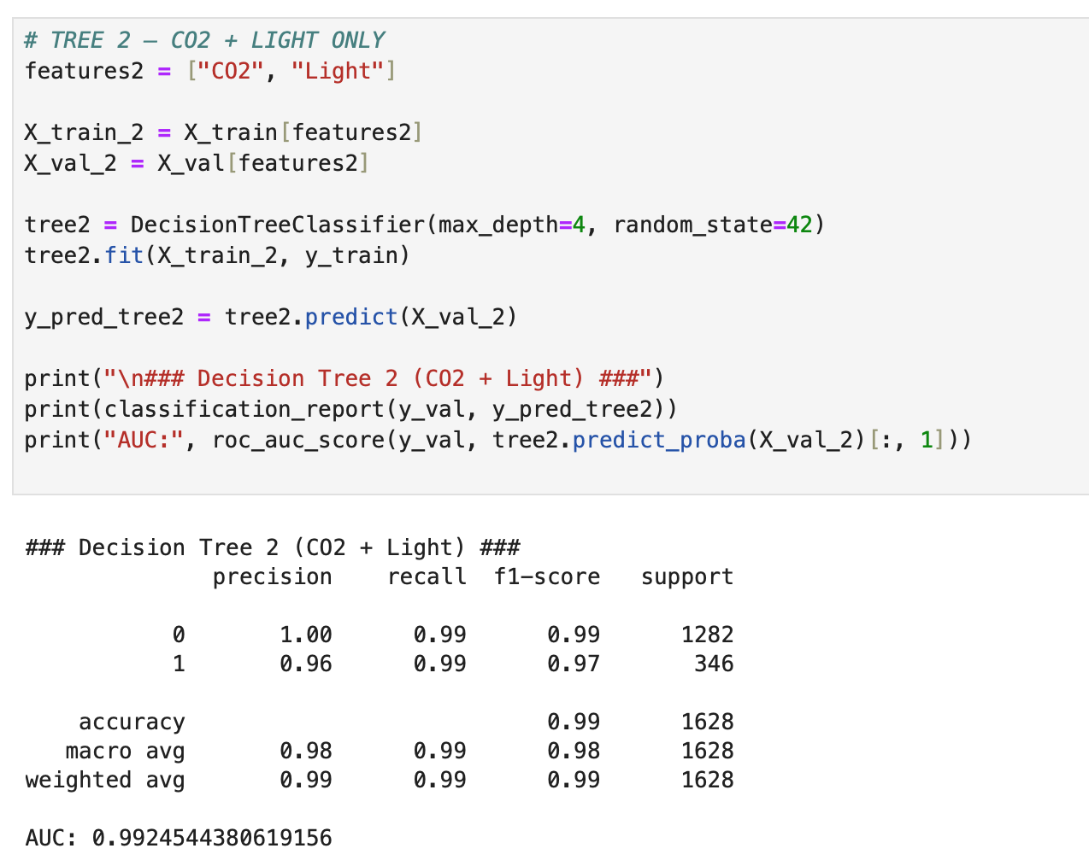
Decision Trees 2
Accuracy: 0.99
AUC: 0.9925
Very strong performance with only 2 predictors
Confirms importance of Light and CO2

Slide 16
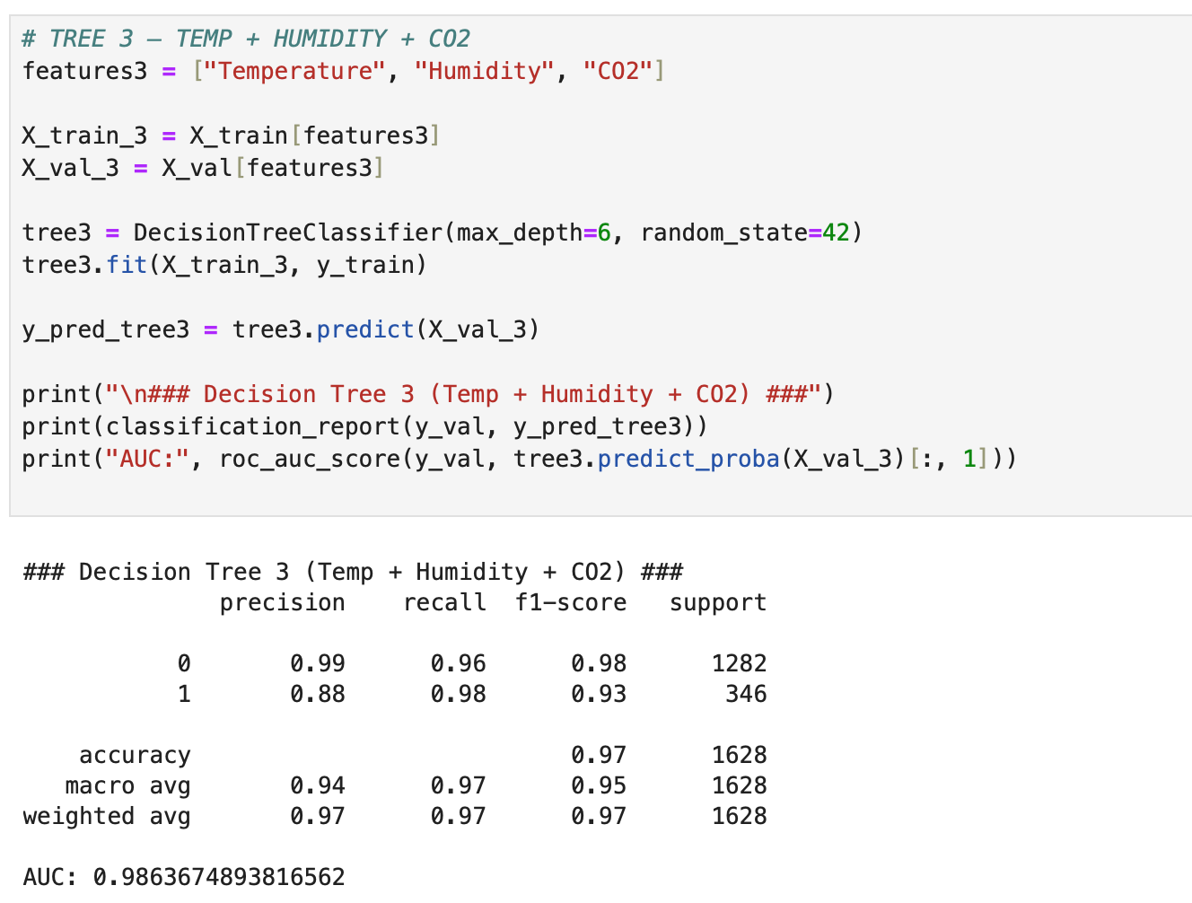
Decision Trees 3
Accuracy: 0.97
AUC: 0.9863
Lower accuracy due to missing Light feature

Slide 17
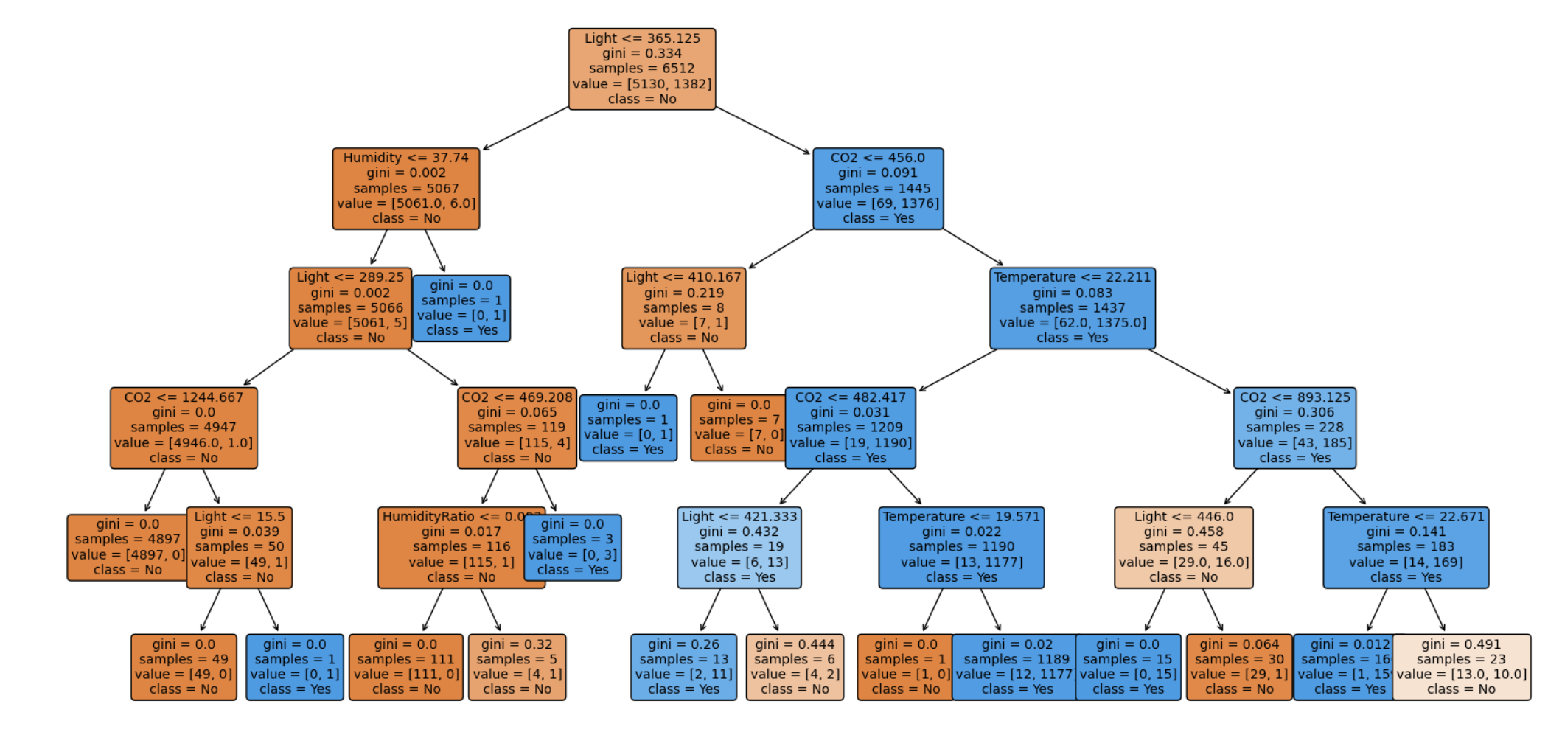
Final Model Choice
Decision Tree 1
Highest accuracy and AUC
Key Insights:
Light and CO2 are the strongest predictors

Slide 18
Conclusion
Cleaned and explored training data
Visualized time series patterns to identify strong predictors
Built and compared multiple decision tree models
Final model achieved perfect validation accuracy
Project demonstrates how environmental sensors can reliably detect occupancy

